Slide 1
CHGM-141
General and Analytical Chemistry I
Lecture 21
(Ch.8) with Dr. Bailey
Energy: Some Basic Principles
The First Law of Thermodynamics
Specific Heat Capacity and Heat Transfer
Enthalpy Changes for chemical Reactions
Calorimetry

Slide 2

What is Energy?
What is Heat?
What is Heat transfer?
How can we figure out amount of Heat?
What are units of Heat?

Slide 3
Nature of Energy
even though Chemistry is the study of matter, energy effects matter
energy is anything that has the capacity to do work
work is a force acting over a distance
  Energy = Work = Force x Distance
energy can be exchanged between objects through contact
  collisions
Classification of Energy…

Slide 4
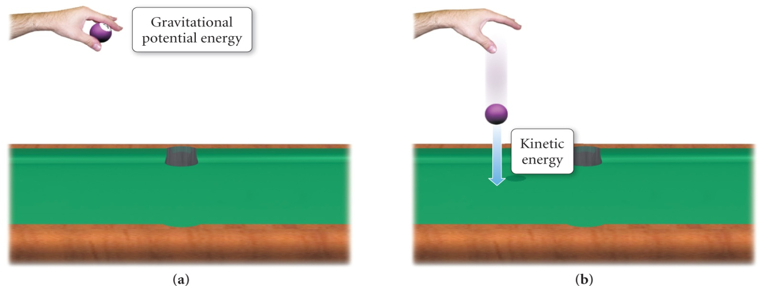
Classification of Energy
Potential energy is energy that is stored in an object, or energy associated with the composition and position of the object
  energy stored in the structure of a compound is potential

Slide 5
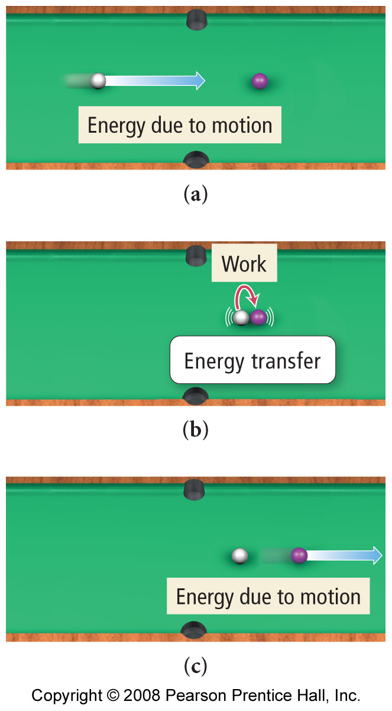
Classification of
Energy
Kinetic energy is energy of motion or energy that is being transferred
  thermal energy is kinetic

Slide 6

Again…
ENERGY is the capacity to do work or transfer heat.
Other forms of energy —
kinetic and potential
light
electrical
Nuclear
Chemical
HEAT is the form of energy that flows between 2 objects because of their difference in temperature.
  the law of
  CONSERVATION OF ENERGY…

Slide 7
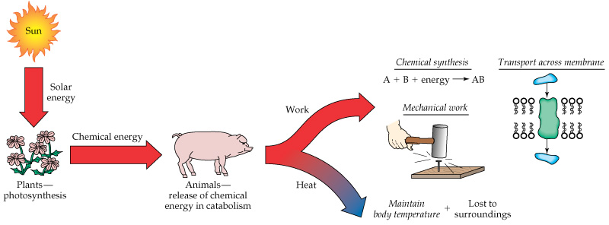
The flow of energy through biosphere
Energy and Life
Energy used by a very few living organisms comes from the sun.
Plants convert sunlight to potential energy stored mainly in the chemical bonds of carbohydrates.
Plant eating animals utilize the energy stored by the plants, some for immediate needs and the rest to be stored for future needs
Other animals, including humans, are able to eat plants and animals and use the chemical energy these organisms have stored.

Slide 8
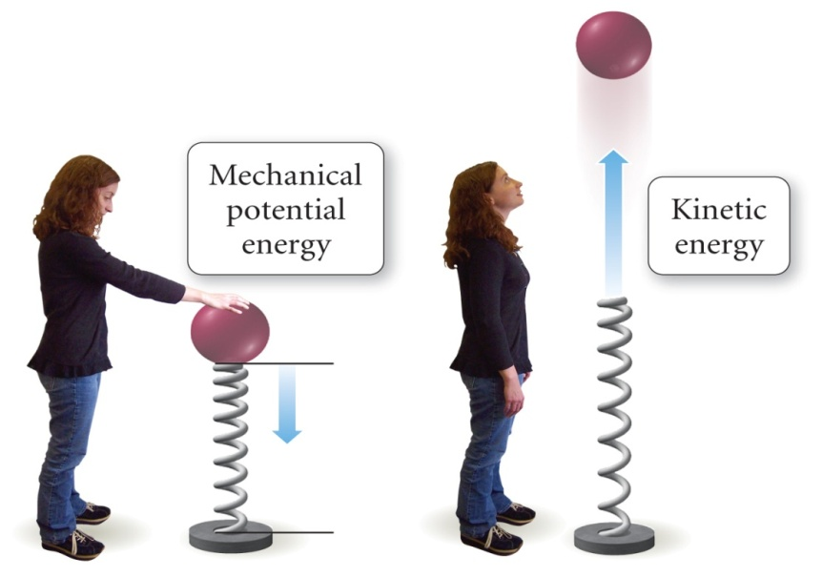
All of thermodynamics depends on the law of
CONSERVATION OF ENERGY
energy cannot be created or destroyed
  First Law of Thermodynamics
energy can be transferred between objects
energy can be transformed from one form to another
  heat → light → sound
We will see that the total energy is unchanged in a chemical reaction.

Slide 9
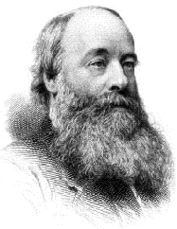
UNITS OF ENERGY
1 calorie = heat required to raise temp. of 1.00 g of H₂O by 1.0 ºC.
1000 cal = 1 kilocalorie = 1 kcal
But we use the unit called the JOULE
1 cal = 4.184 joules
The calories we eat are actually kilocalories
James Joule
1818-1889

Slide 10
Energy Use
Unit | Energy Required to Raise Temperature of 1 g of Water by 1°C | Energy Required to Light 100-W Bulb for 1 Hour | Energy Used by Average U.S. Citizen in 1 Day
joule (J) | 4.18 | 3.6 x 10⁵ | 9.0 x 10⁸
calorie (cal) | 1.00 | 8.60 x 10⁴ | 2.2 x 10⁸
Calorie (Cal) | 1.00 x 10⁻³ | 86.0 | 2.2 x 10⁵
kWh (kilowatt-hour) | 1.1 x 10⁻⁶ | 0.100 | 2.50 x 10²

Slide 11

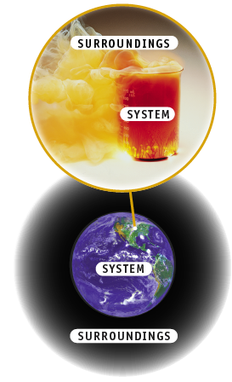
SYSTEM
  The object under study
SURROUNDINGS
  Everything outside the system

Slide 12

The focus of our chemical interest is called the system
Everything outside the system is called the surroundings
A boundary separates the system from the surroundings
The system and surroundings together are called the universe

Slide 13
Internal Energy of Molecules: State Functions
First Law of Thermodynamics (law of CONSERVATION OF ENERGY): The total internal energy E of an isolated system is constant.
The internal energy is the total amount of kinetic and potential energy a system possesses
State Functions…
Internal Energy of Molecules: State Functions…

Slide 14
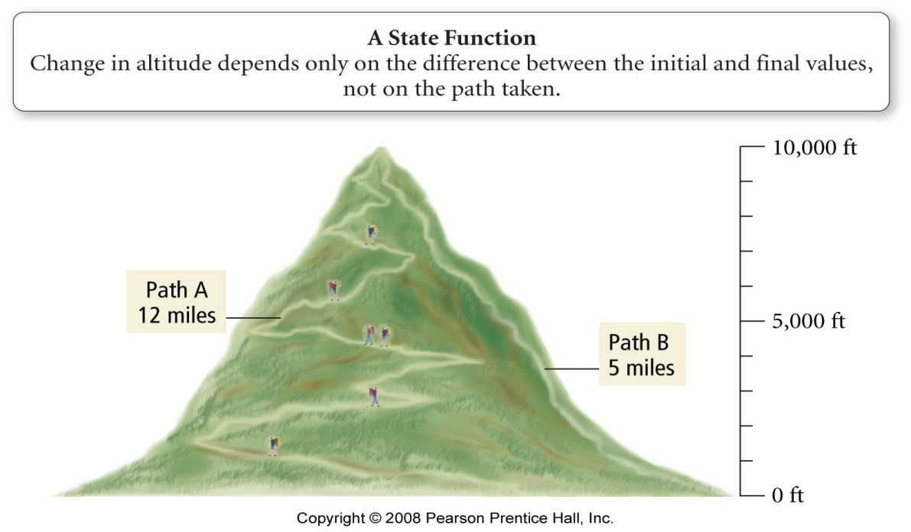
Internal Energy of Molecules:
State Functions
the change in the internal energy of a system only depends on the amount of energy in the system at the beginning and end
  a state function is a mathematical function or property whose result only depends on the initial and final conditions, not on the process (path) used to arrive at that state.
  ΔE = E_{final} – E_{initial}
  ΔE_{reaction} = E_{products} - E_{reactants}

Slide 15
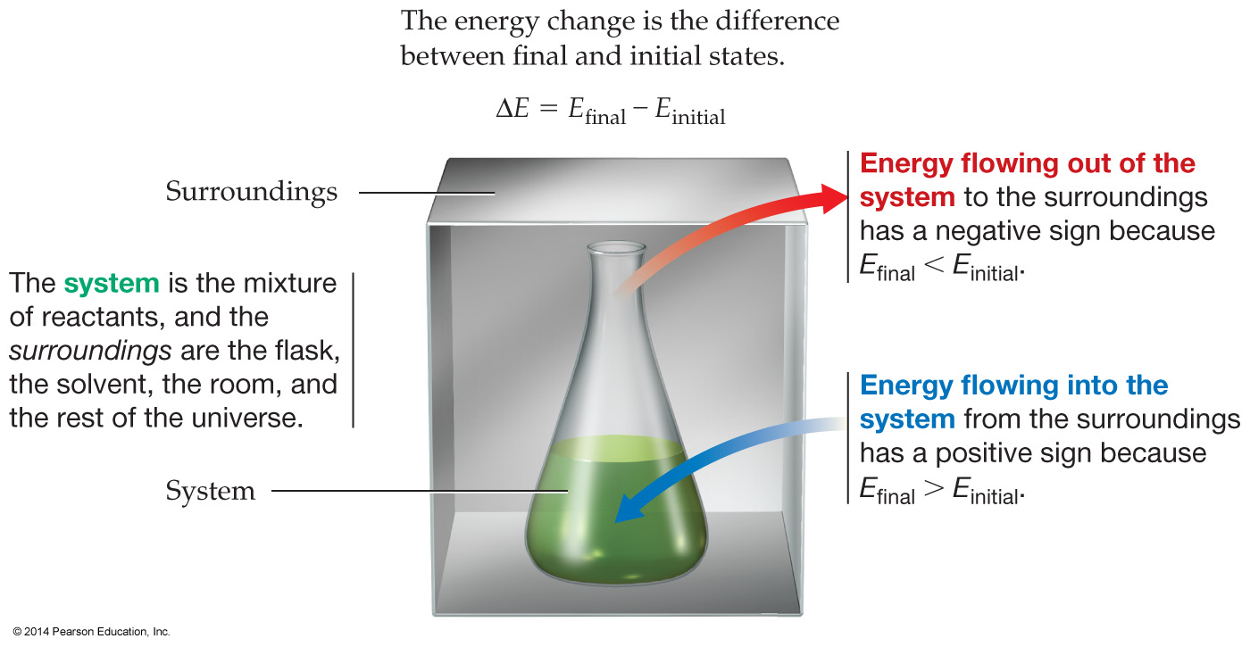
Internal Energy of Molecules: State Functions
Example:
∆E = E_{final} - E_{initial}
Example…
Notes:
Chapter 8: Thermochemistry: Chemical Energy
Copyright © 2010 Pearson Prentice Hall, Inc.
Restating the first law.

Slide 16
Internal Energy of Molecules:
State Functions
Example:
CH₄(g) + 2 O₂(g)
CO₂(g) + 2 H₂O(g) + 802 kJ energy
∆E = E_{final} - E_{initial} = -802 kJ
802 kJ is released when 1 mole of methane, CH₄, reacts with 2 moles of oxygen to produce 1 mole of carbon dioxide and 2 moles of water.
Just as energy comes in many forms,
so too does work …
Notes:
Chapter 8: Thermochemistry: Chemical Energy
Copyright © 2010 Pearson Prentice Hall, Inc.

Slide 17
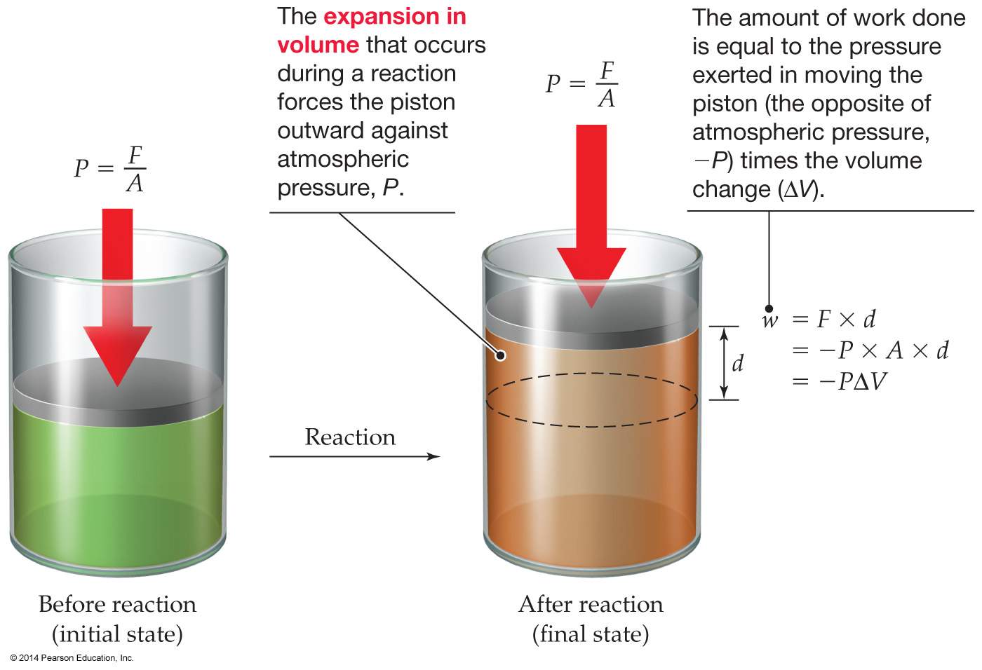
Expansion Work Done by Reactions
Just as energy comes in many forms,
so too does work .
The most common type of work in chemical system is the expansion work: Work done as the result of a volume change in the system.
Also called pressure-volume, or PV, work.
Work = Force x Distance
w = F x d
Example..
Notes:
Chapter 8: Thermochemistry: Chemical Energy
Copyright © 2010 Pearson Prentice Hall, Inc.

Slide 18
Expansion Work Done by Reactions
C₃H₈(g) + 5 O₂(g)
3 CO₂(g) + 4 H₂O(g)
6 mol of gas
7 mol of gas
If there is no volume change,
then ΔV = 0 and there is no work:
CH₄(g) + 2 O₂(g) → CO₂(g) + 2 H₂O(g
Notes:
Chapter 8: Thermochemistry: Chemical Energy
Copyright © 2010 Pearson Prentice Hall, Inc.

Slide 19

How Is Energy Exchanged?
energy is exchanged between the system and surroundings through either heat exchange or work being done
  q = heat (thermal) energy
  w = work energy

Slide 20
How Is Energy Exchanged? (Cont.)
Energy is exchanged between the system and surroundings through heat and work
  q = heat (thermal) energy
  w = work energy
  q and w are NOT state functions, their value depends on the process
  According to the first law of thermodynamics, the change in the internal energy of the system (ΔE) must be the sum of the heat transferred (q) and the work done
ΔE = q + w
q (heat) | system gains heat energy + | system releases heat energy ─
w (work) | system gains energy from work + | system releases energy by doing work ─
ΔE | system gains energy + | system releases energy ─
Example..

Slide 21
Use of the 1st Law
Example:
A SYSTEM UNDERGOES A PROCESS CONSISTING OF TWO STEPS:
1. The system absorbs 72 J of heat while 35 J of work is done on it.
2. The system absorbs 35 J of heat wile performing 72 J of work.
Determine the change in the internal energy of the system (ΔE) for the overall process
ΔE = q + w
Step 1: ΔE₁ = 72 + 35 = 107 J
Step 2: ΔE₂ = 35 – 72 = -37 J
____________________________
ΔE(total) = ΔE₁ + ΔE₂ = 107 + (-37 ) = +70 J

Slide 22
Heat Exchange
heat is the exchange of thermal energy between the system and surroundings
occurs when system and surroundings have a difference in temperature
heat flows from matter with high temperature to matter with low temperature until both objects reach the same temperature
  thermal equilibrium

Slide 23

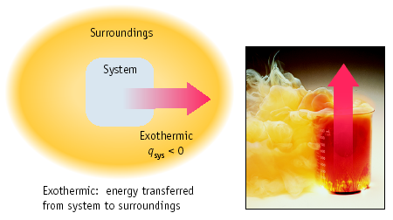

Heat always transfers from hotter object to cooler one.
EXOthermic: heat transfers from SYSTEM to SURROUNDINGS.
T(system) goes down
T(surr) goes up

Slide 24
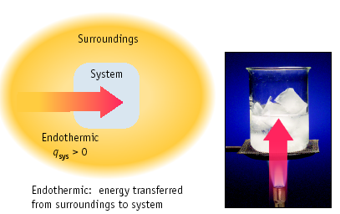
Heat always transfers from hotter object to cooler one.
ENDOthermic: heat transfers from SURROUNDINGS to the SYSTEM.
T(system) goes up
T (surr) goes down

Slide 25
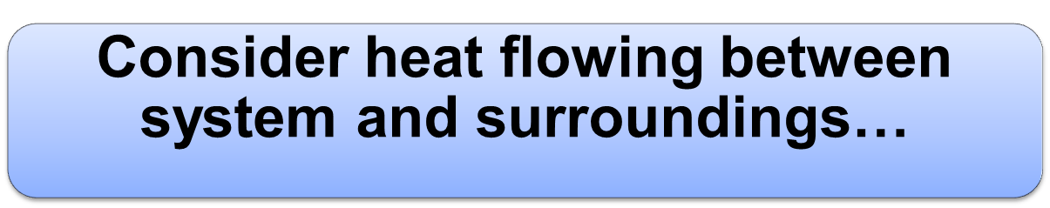
Again…The sign of the heat change is used to say whether it was gained or lost
  When heat is gained by an object, it is written as a positive number
    There is an increase in the object’s internal energy.
  When heat is lost by an object, it is written as a negative number
    There is a decrease in the object’s internal energy.
Furthermore…

Slide 26

What is heat?
What is temperature?
How are they linked?

Slide 27
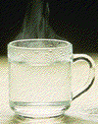

HEAT CAPACITY
The heat required to raise an object’s T by 1 ˚C (or K).
Which has the larger heat capacity?

Slide 28
Quantity of Heat Energy Absorbed
HEAT CAPACITY
C - heat capacity
  units of C are J/°C or J/K
the heat capacity (C) of an object depends on its mass
  200 g of water requires twice as much heat to raise its temperature by 1°C than 100 g of water
the heat capacity of an object depends on the type of material
  1000 J of heat energy will raise the temperature of 100 g of sand 12°C, but only raise the temperature of 100 g of water by 2.4°C
  Quantity of Heat Energy Absorbed :
  q = C x ΔT

Slide 29
Heat Capacity
Heat Capacity (C): The amount of heat required to raise a body’s (object’s) temperature by 1K (or ˚C).
q = C x ∆T
Molar Heat Capacity (C_{m}): The amount of heat required to raise the temperature of 1 mol of a pure substance by 1K (or ˚C).
q = (C_{m}) x (moles of substance) x ∆T
Specific Heat Capacity (c): The amount of heat required to raise the temperature of 1 g of a pure substance by 1K (or ˚C). Sometimes just called specific heat.
q = (specific heat) x (mass of substance) x ∆T
Notes:
Chapter 8: Thermochemistry: Chemical Energy
Copyright © 2010 Pearson Prentice Hall, Inc.
∆T is the temperature change.
Heat capacity is an extensive property.
Specific heat is an intensive property.

Slide 30
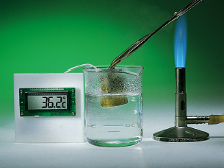
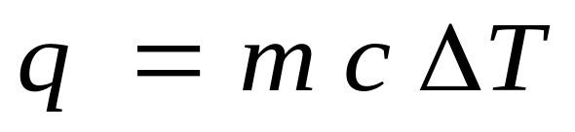
Specific Heat Capacity
How much energy is transferred due to T difference?
The heat (q) “lost” or “gained” is related to
a) sample mass
b) change in T and
c) specific heat capacity
C is Spec. Heat capacity (J/g•K)

Slide 31
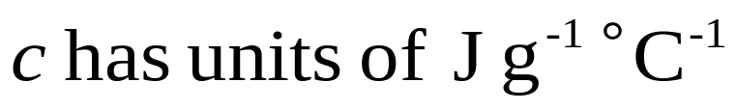
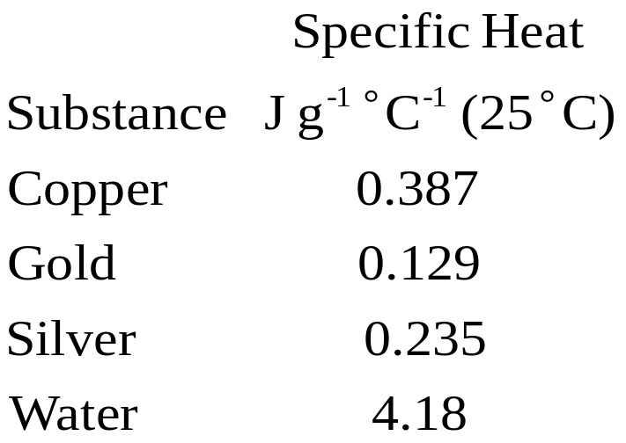
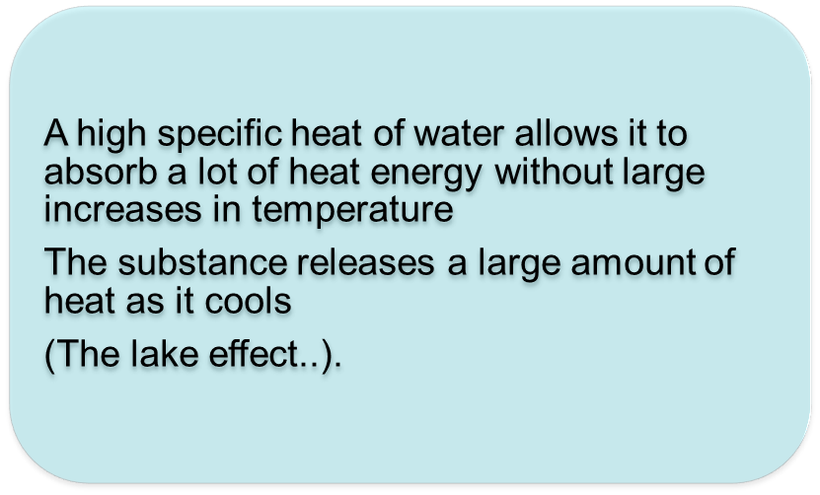
The specific heat capacity (c, or sometimes “s”) is an intensive property, and is unique for each substance.
Heat released or absorbed:
E.g.
  keeping ocean shore communities and beaches cool in the summer

Slide 32
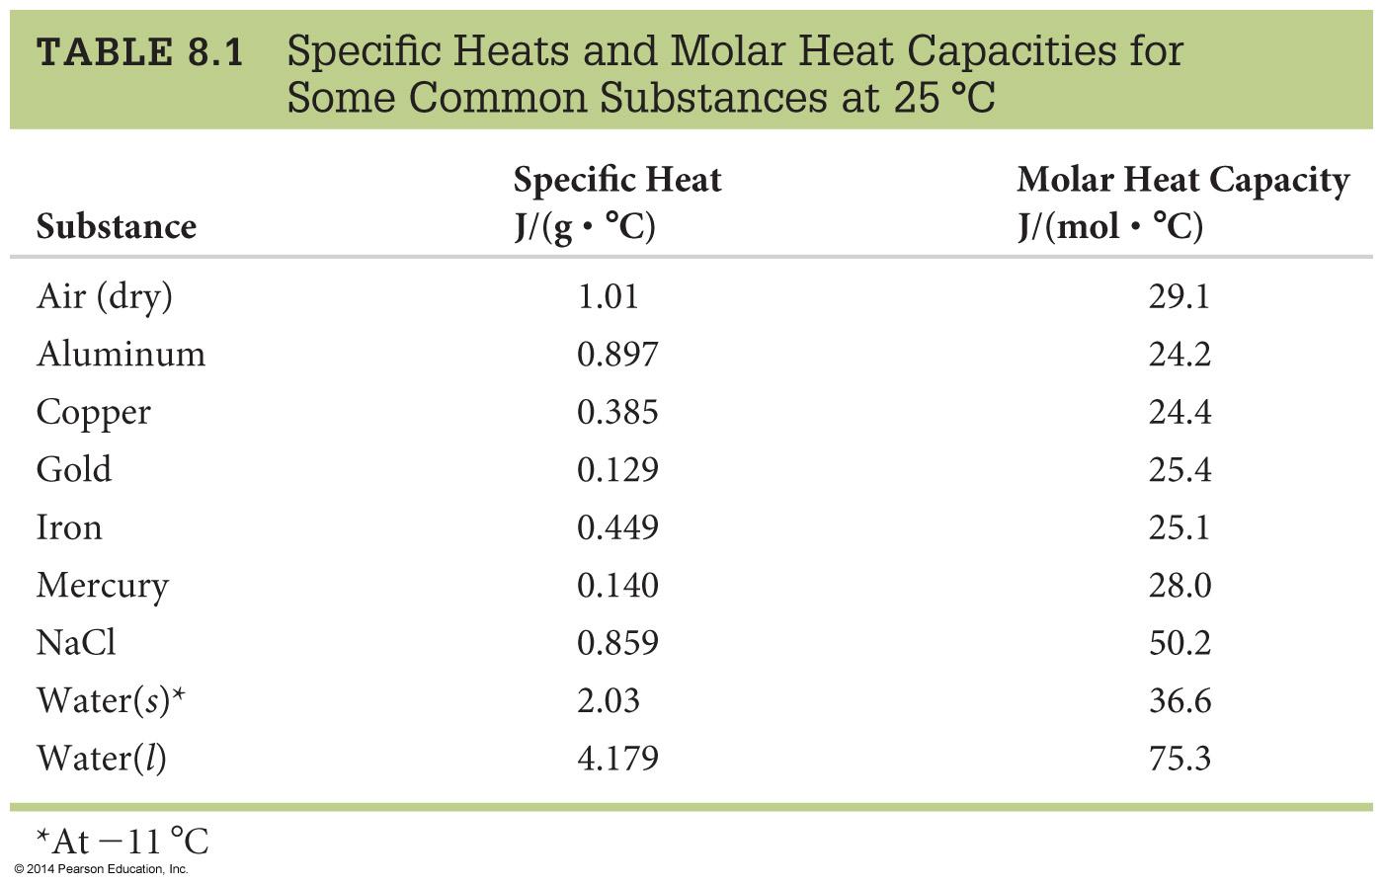
Note that the values for water are considerably higher than most other substances
The human body is approximately 60% water and the role it plays in homeostasis, etc.
Example of calculations…
Notes:
Chapter 8: Thermochemistry: Chemical Energy
Copyright © 2010 Pearson Prentice Hall, Inc.
Note that the values for water are considerably higher than most other substances. Interesting discussion points could be how large bodies of water affect weather; the human body is approximately 60% water and the role it plays in homeostasis, etc.

Slide 33
Specific Heat Capacity
If 25.0 g of Al cool from 310 ºC to 37 ºC, how many joules of heat energy are lost by the Al?
heat gain/lose = q = (sp. ht.)(mass)(∆T)
where ∆T = T_{final} - T_{initial}
q = (0.897 J/g•K)(25.0 g)(37 - 310)K
q = - 6120 J
Notice that the negative sign on q signals heat “lost by” or transferred OUT of Al.
Measure Heat Transfer…

Slide 34
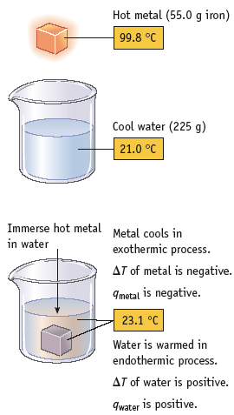
Measure Heat Transfer
Use heat transfer as a way to find specific heat capacity, C_{p}
55.0 g Fe at 99.8 ˚C
Drop into 225 g water at 21.0 ˚C
Water and metal come to 23.1 ˚C
What is the specific heat capacity of the metal?

Slide 35
What happens?
Measure Heat Transfer (Cont.)
225g Cool water at 21.0ºC
55.0g Hot metal at 99.8ºC
Combined system comes to 23.1ºC
Hot body transfers heat to cold body
Temperature equilibrates

Slide 36
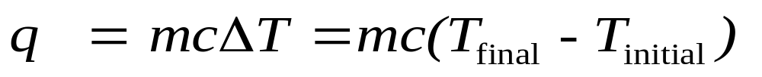
What information do we have?
225g Cool water at 21.0ºC
Temperature of water goes up!
Heat gained by water =
225 g x 4.184 J/g•K x (23.1-21.0) ºC =
1.98 x 10³J = 1.98 kJ
Where did this heat come from?

Slide 37
The heat came from the metal…
55.0g hot metal at 99.8ºC
Temperature of metal goes down!
Heat lost by metal = 1.98 x 10³J = 1.98 kJ
So
-1.98 x 10³J = 55.0 g x c_{metal} x (23.1-99.8) ºC
c_{metal} = 0.469 J/g•K
But can we use ºC and K?

Slide 38
The heat came from the metal…
(23.1-99.8) ºC = (296.1-372.8) K
= -76.7 ºC or -76.7 K
So we can interconvert in this case!!

Slide 39
Energy Change in Chemical Processes

Slide 40

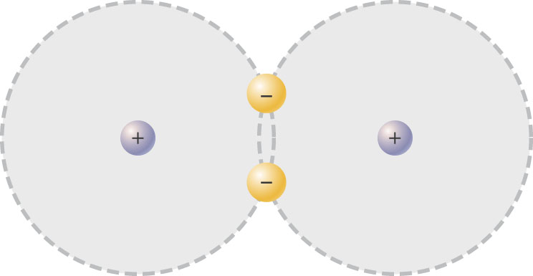
Chemical bonds are the net attractive force between nuclei and electrons in compounds
The potential energy that resides in chemical bonds is called chemical energy
Breaking a chemical bond requires energy
Making a chemical bond releases energy
E.g. attraction of electrons for nuclei in H₂ molecule is strong enough to overcome nucleus-nucleus and electron-electron repulsions.

Slide 41
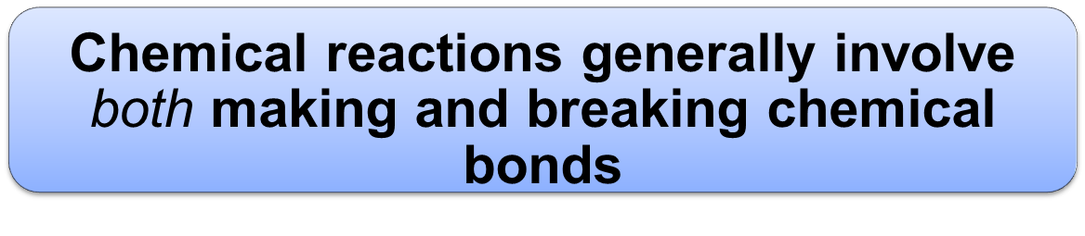
All of thermodynamics depends on the law of CONSERVATION OF ENERGY.
The total energy is unchanged in a chemical reaction.
Net gain or loss of energy often in the form of heat
Any reaction where heat is a product is called exothermic
Reactions that consume energy are called endothermic

Slide 42
Potential energy. Kinetic energy
1. Exothermic Reactions
When a system loses potential energy, that energy must be converted to kinetic energy.
During the course of a reaction, old bonds are broken and new bonds made
The products of the reaction have less chemical potential energy than the reactants.
Reactions replace “weak” bonds with “strong” ones
System loses internal energy
The difference in energy is released as heat
The temperature (surrounding) rises due to release of thermal energy
Bob loses Potential energy but gains
kinetic energy
Reactants
Amount of energy released
Potential energy
Products

Slide 43
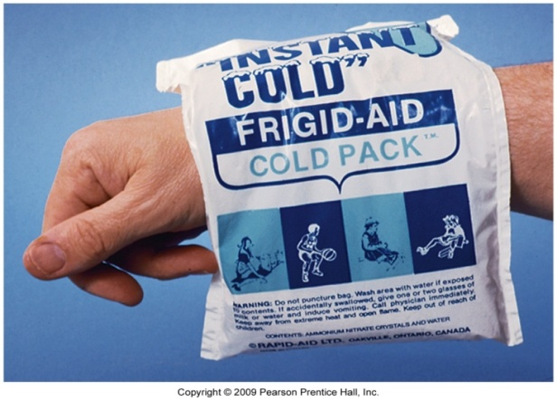
2. An Endothermic Reaction
Surroundings
reaction
An endothermic chemical reaction occurs when the products have more chemical potential energy than the reactants.
The required energy is absorbed from the surrounding materials, taking energy from them; the temperature drops due to absorption of thermal energy
Some of the thermal energy of the surroundings is converted into chemical potential energy stored in the products
Products
Amount of energy absorbed
Potential energy
Reactants

Slide 44
Let’s come back…
Internal Energy
and Enthalpy of Molecules
We can represent the total change
In the internal energy of a system:
∆E = q + w
w = work = - P∆V
q = heat transferred
Rearranging the equation to solve for
The amount of heat transferred:
q = ∆E + P∆V
1. Constant Volume (∆V = 0):
q_{V} = ∆E
2. Constant Pressure:
q_{P} = ∆E + P∆V
Notes:
Chapter 8: Thermochemistry: Chemical Energy
Copyright © 2010 Pearson Prentice Hall, Inc.

Slide 45
Internal Energy and Enthalpy of Molecules
At constant pressure:
q_{P} = ∆E + P∆V =
∆H
Most chemical reactions are often carried out open to the atmosphere, at constant atmospheric pressure P.
A special name and symbol for the heat of reaction: enthalpy change ∆H
Enthalpy change
or
Heat of reaction
(at constant pressure)
Enthalpy is a state function whose value depends only on the current state of the system, not on the path taken to arrive at that state.
∆H = H_{final} - H_{initial}
= H_{products} - H_{reactants}
Notes:
Chapter 8: Thermochemistry: Chemical Energy
Copyright © 2010 Pearson Prentice Hall, Inc.

Slide 46
ENTHALPY
Most chemical reactions are often carried out open to the atmosphere, at constant atmospheric pressure P.
Heat transferred at constant P _{p}
q_{p} = ∆H where H = enthalpy
The enthalpy is a comparison of the bond energy of the reactants to the products.
  bond energy = amount needed to break a bond.
∆H_{rxn} = (bond dissociation energy)reactants
- (bond dissociation energy)products
Recall..

Slide 47
Bond Strength
(Bond energy, bond dissociation energy)
Recall…
Bond Strength: The amount of energy that must be supplied to break a bond and separate the atoms in an isolated gaseous molecule.
BOND STRENGTH (kJ/mol)
H—H 436
C—C 346
C=C 602
C≡C 835
N≡N 945

Slide 48
ENTHALPY
∆H = H_{final} - H_{initial}
If H_{final} > H_{initial} then ∆H is positive
Process is ENDOTHERMIC
If H_{final} < H_{initial} then ∆H is negative
Process is EXOTHERMIC
Again…
  At constant pressure this heat is described as a change in enthalpy
The enthalpy change extensive property…

Slide 49
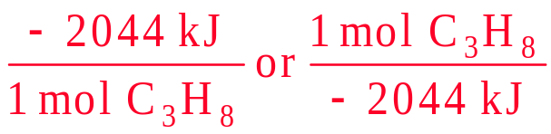
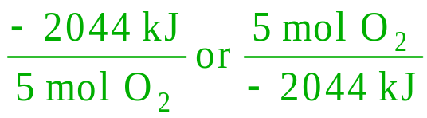
Enthalpy of Reaction
The enthalpy change in a chemical reaction is an extensive property
  the more reactants you use, the larger the enthalpy change
By convention, we calculate the enthalpy change for the number of moles of reactants in the reaction as written
C₃H₈(g) + 5 O₂(g) → 3 CO₂(g) + 4 H₂O(g) ΔH = -2044 kJ

ΔH_{reaction} for 1 mol C₃H₈ = -2044 kJ
ΔH_{reaction} for 5 mol O₂ = -2044 kJ

Slide 50
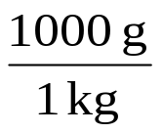
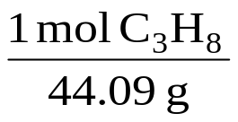
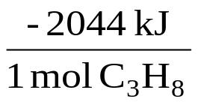
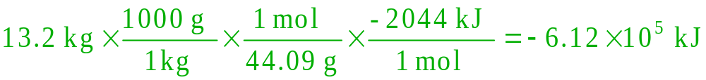
Example – How much heat is evolved in the complete combustion of 13.2 kg of C₃H₈(g)?
C₃H₈(g) + 5 O₂(g) → 3 CO₂(g) + 4 H₂O(g) ΔH = -2044 kJ
Given:
Find:
13.2 kg C₃H₈,
q, kJ/mol
Concept Plan:
Relationships:
1 kg = 1000 g, 1 mol C₃H₈ = -2044 kJ, Molar Mass = 44.09 g/mol
kg
g
mol
kJ
Solution:
Check:
the sign is correct and the value is reasonable

Slide 51
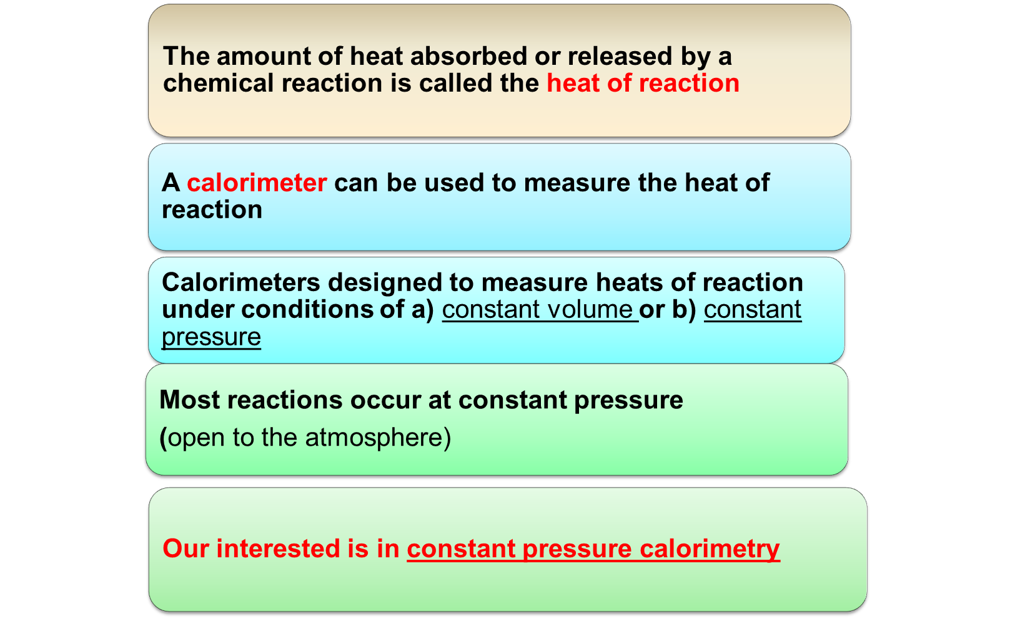

Slide 52
Measuring Heats of Reaction
CALORIMETRY

Slide 53

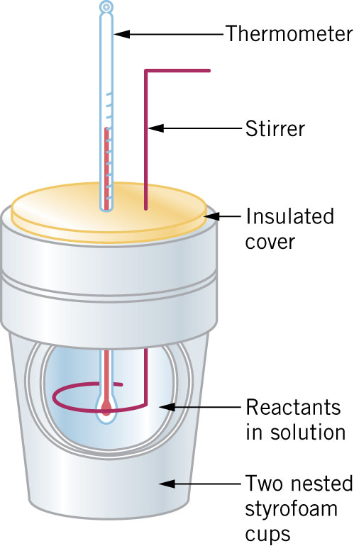
A coffee cup calorimeter can be used to measure heats of reaction at constant pressure.
Heat can be released or absorbed, resulting in a change in temperature of the solution.
Amount of heat that a reaction produces or absorbs depends on the number of moles of reactant that react

Slide 54
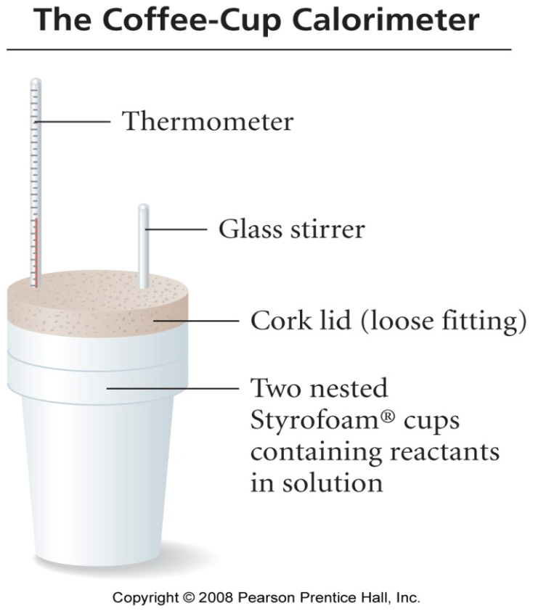
Measuring ΔH
Calorimetry at Constant Pressure
reactions done in aqueous solution are at constant pressure
  open to the atmosphere
the calorimeter is often nested foam cups containing the solution
ΔH_{reaction} = q_{constant pressure} = q_{reaction}
q_{reaction} = ─ q_{solution} = ─ (mass_{solution} x C_{s, solution} x ΔT)
  to get ΔH_{reaction} per mol, divide by the number of moles

Slide 55
Example:
You mix 110.0mL of 0.500 M CsOH with 120mL of 0.458 M HCl in a coffee cup calorimeter, and the temperature of both solutions rises from 23.40°C before mixing, to 24.90°C after the reaction.
CsOH (aq) + HCl (aq) → CsCl (aq) + H₂O (l)
What is the enthalpy of reaction per mole of CsOH?
Assume the densities of the solutions are all 1.00 g/mL and the specific heats of the solutions are 4.2 J/(g·K).
What’s happening here?

Slide 56

What’s happening here?
  A reaction occurs that yields heat
  The temperature of the solution rises
  The temperature change allows us to calculate an enthalpy change that is taking place as we move from reactants to products

Slide 57
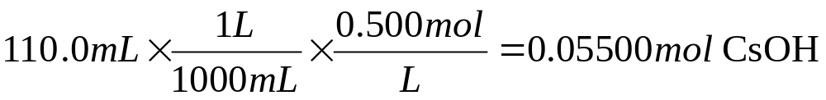
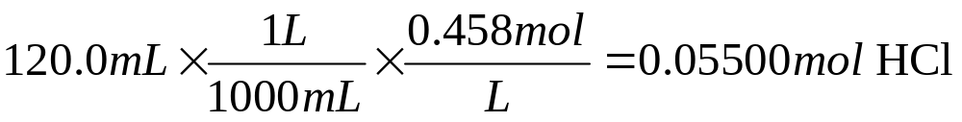
Given…
CsOH (aq) + HCl (aq) → CsCl (aq) + H₂O (l)
So we should recognize that the formation of 0.005500 mol water (0.1mL) by the complete reaction of 0.05500 mol CsOH has led to an increase in temperature of 1.50 °C
What else can we do?

Slide 58
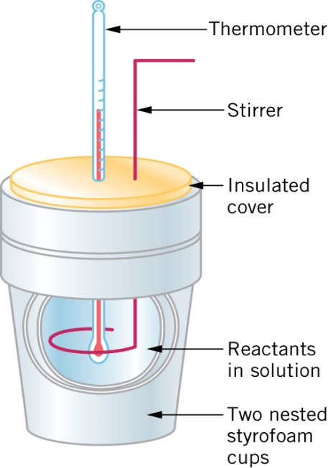
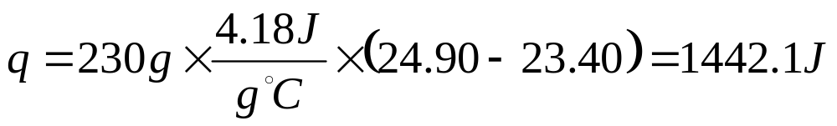
Heat released gave rise to a temperature change
We are given a specific heat capacity…
Mass is mass of the water (volume = 110.0mL + 120mL), based on density of 1.00 g/mL
Hence the complete reaction of 0.05500 mol CsOH has led to 1442.1 J being released
So what is the enthalpy of reaction for one mole of CsOH?

Slide 59
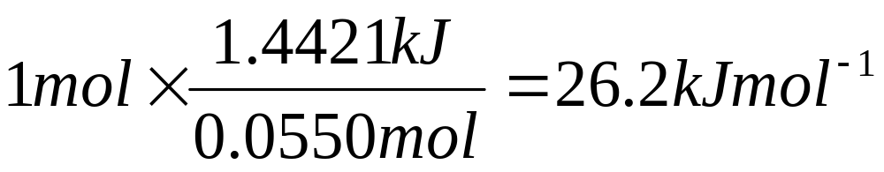
1442.1 J = 1.4421 kJ per 0.0550 mol CsOH
Therefore 26.2 kJ are released for every mole of reaction that occurs.

Slide 60
More examples…

Slide 61


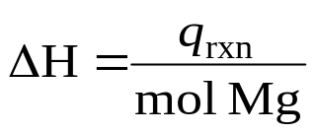
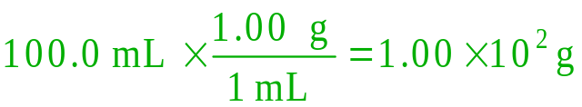
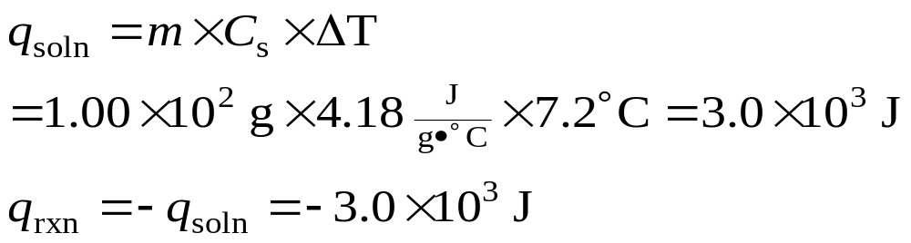
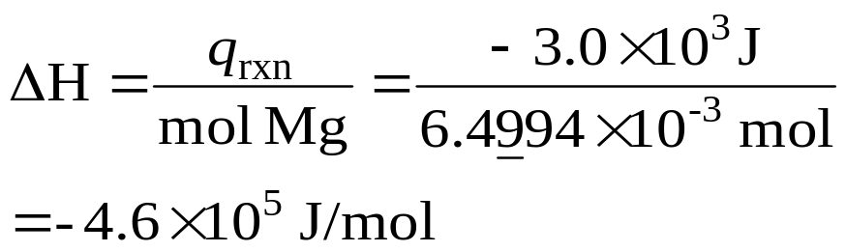
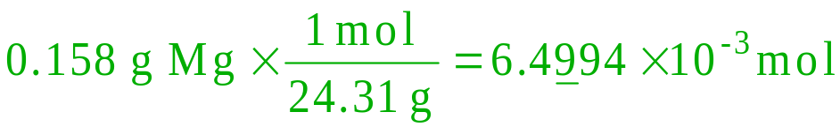
Example – What is ΔH_{rxn/mol Mg} for the reaction
Mg(s) + 2 HCl(aq) → MgCl₂(aq) + H₂(g) if 0.158 g Mg reacts in
100.0 mL of solution to change the temperature from 25.6°C to 32.8°C?
Given:
Find:
0.158 g Mg, 100.0 mL sol’n, T₁ = 25.6°C, T₂ = 32.8°C, C_{s} = 4.18 J/°C, d_{soln} = 1.00 g/mL
ΔH_{rxn}, J/mol Mg
q_{soln} = m x C_{s} x ΔT = -q_{rxn}
Concept Plan:
Relationships:
m, C_{s}, ΔT
q_{soln}
q_{soln}
q_{rxn}
Solution:
Check:
the units and sign are correct

